Slide 1



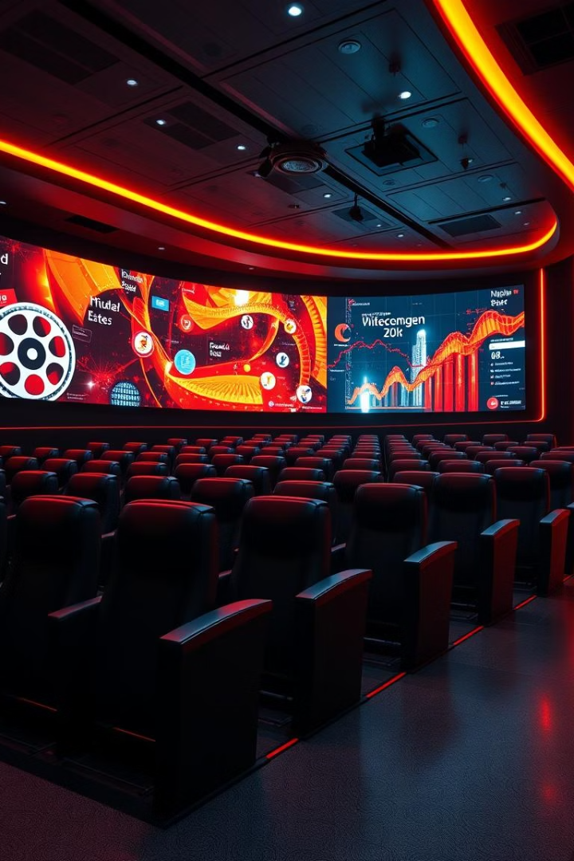
Movie Recommendation Systems Design Implementation and Evaluation
By: MRS Team
Movie Recommendation Systems Design Implementation and Evaluation By: MRS Team

Slide 2
CONTENTS
1. Introduction
2. Metadata preprocessing phase
3. Model Selection and Implementation
4. Algorithm Choice
5. Implementation and Deployment
6. Evaluation Metrics and Analysis
7. Results Interpretation and Opportunities

Slide 3
01
Overview of Recommendation Systems
This presentation focuses on a movie recommendation system combining both content-based and collaborative filtering techniques.
They aim to predict and suggest items that are likely to satisfy the user's preferences.
Recommendation systems are crucial tools for engaging users in content platforms.

Slide 4


02
Metadata preprocessing phase
Data Cleaning
Handling Missing Values
Final Output
Irrelevant columns like social media likes and budget were removed. Textual data such as genres and keywords were normalized for consistency.
Missing critical fields were filled using the OMDb API, with mean/mode imputation for numeric and categorical data. Manual cleanup addressed malformed strings and non-standard characters.
The enriched dataset was saved as updated_movies.csv, ready for use in recommendation algorithms.

Slide 5
03
Model Selection and Implementation

Slide 6





Content-Based Filtering Workflow Steps for Implementation
A feature (such as genre or actor) is selected for analysis.
User inputs a movie title or tag.
2
1
3
TF-IDF vectors are calculated for that feature across all movies.
5
Top similar movies are filtered and sorted by IMDb score to increase recommendation quality.
4
Cosine similarity scores are computed to find likeness.

Slide 7
Collaborative Filtering Workflow/Data Preparation and Processing
Load user ratings and movie metadata, ensuring all data is clean and merged.
Split data (e.g., 80% train, 20% test) for training and evaluation.
Build a sparse matrix of users vs. movie ratings to model relationships.

Slide 8



Collaborative Filtering Workflow/ Model Training and Recommendation Generation
2
Find similar users and recommend movies they liked that the target user hasn't seen.
Use KNN with cosine similarity on the sparse matrix to capture user preference.
1
3
Evaluate model performance using metrics like Precision@k.

Slide 9



04
Algorithm Choice
Justification of Algorithms/Reasoning for Algorithm Selection
Content-Based Filtering (TF-IDF) leverages movie metadata for recommendations.
Collaborative Filtering (KNN) is based on user behavior, suitable for diverse datasets.
This hybrid approach is efficient for both new and experienced users, increasing robustness.

Slide 10



Justification of Algorithms/Explanation of KNN
It excels in explicit rating data and is computationally less intensive.
Although more complex methods exist, KNN provides a strong baseline with lower costs.
KNN is chosen for its simplicity and interpretability.
2
1
3

Slide 11





Algorithm Effectiveness/Evaluation of Code Structure
2
Use of csr_matrix optimizes memory usage, especially for large sparse datasets.
Code is readable and logically organized, enhancing maintainability.
1
Potential improvements include modularizing code for scalability.
3

Slide 12



05
Implementation and Deployment
Libraries and Tools/Essential Technologies Utilized
1
Scikit-learn, scipy, and pandas provide foundational tools for data manipulation.
2
More advanced systems might employ SVD or deep learning, but KNN remains effective in current scope.

Slide 13


Hyperparameter Tuning/Evaluating Hyperparameters
Tuned the n_neighbors hyperparameter for optimal performance.
1
2
Each value of k is evaluated using Precision K to refine recommendations.

Slide 14



Deployment Strategy/Deployment Steps
Deployed the model using ngrok to make the Flask application accessible via a public URL.
Steps involved local execution and public sharing, allowing user interaction without local execution.

Slide 15



06
Evaluation Metrics and Analysis
2
Recall assesses how many relevant items from the test set are actually recommended.
Precision measures the proportion of recommended movies that are relevant.
1
F1 Score, harmonizing precision and recall, offers balanced metric insight.
3

Slide 16


Test Case Design
Created a test set with a mix of popular franchises and standalone blockbusters to evaluate model efficacy.
Specific titles used include "Man of Steel," "Star Wars," "The Amazing Spider-Man 2," and "Avatar."

Slide 17


07
Results Interpretation and Opportunities
Analysis of Results
The model shows strong performance with metrics indicating high relevance in retrieval.
Limitations exist due to a small, manually curated test set and semantic-based matching.
1
2

Slide 18

Future Work
Incorporate Item-Based Collaborative Filtering
Address the Cold Start Problem
Explore Hybrid Approaches blending both filtering methods
User Feedback Loop
Performance Scaling

Slide 19
Summary of System Capabilities
Data Preprocessing
Content-Based
Ensures clean, enriched input for accurate recommendations.
3
Uses NLP techniques for personalized movie suggestions.
1
Evaluation & Extensibility
2
Validated with standard metrics and designed for future enhancements.
Collaborative Filtering
4
Leverages user similarity to recommend unseen movies.

Slide 20
Thank You
Team Members
MennaTallah Srour Mohamed (TL)
Yassmin yousery imam Muhammad
Hassan Elsayed Abdelfattah
Khalid Omar Sedik
Noha Yahia Ibrahim Elsaadawy

